Slide 1

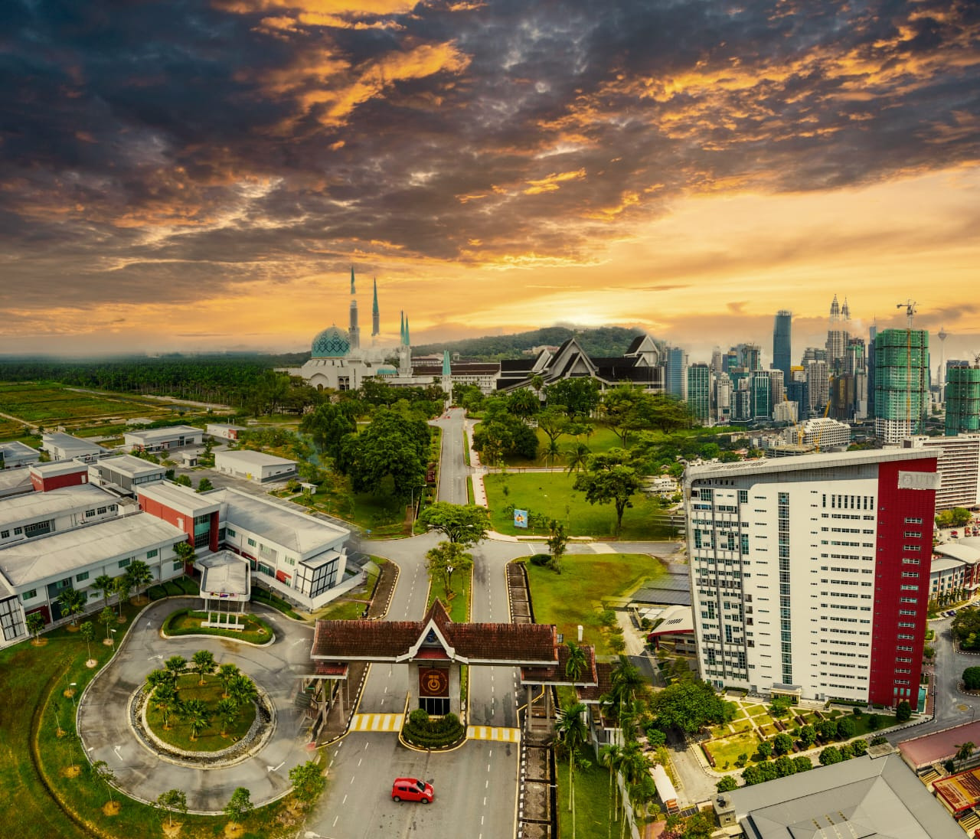


UNIVERSITI TEKNOLOGI MALAYSIA
SECP3623 - DATABASE PROGRAMMING
2025/2026 - SEM 1
Project 1
Prepared by: Group 4
Notes:
Greetings Dr Shamini! My name is Afiq and we are from group 4 will be presenting our project 1

Slide 2



UNIVERSITI TEKNOLOGI MALAYSIA
PRESENTATION SLIDE
HOSTEL RESERVATION SYSTEM
www.utm.my
Notes:
So, we choose to implement a hostel reservation system for university institution.

Slide 3

01
MUHAMMAD AFIQ DANISH BIN MOHD HAZNI
Design overall database structure
Applied key constraints
Ensure smooth integration between tables
Team
Roles
02
DHESHIEGHAN A/L SARAVANA MOORTHY
Data Manipulation & Query Developer (DML + DQL)
03
MUHAMMAD SYAHMI FARIS BIN RUSLI
Query Specialist
Developed all DQL queries
Generated outputs and validated results
Ensured accurate data retrieval across tables
04
PRAVINRAJ A/L SIVABATHI
Indexing & Optimization Analyst
www.utm.my
Notes:
Before going further, my role in this project is a database designer, which i designed the overall database structure for the system. I identified all the entities, planned their relationships and create every necessary tables. I also applied key constraints on those table to ensure smooth integration between tables.

Slide 4


Introduction of the System
Simple backend for managing student room booking and payments
Designed for university hostels to organize: applications, assignments and payments
www.utm.my
Notes:
Our system is a simple backend for managing student room booking and payments. It is specifically designed for university hostels to handle the applications, hostel assignments and payments.

Slide 5


Objectives of the System
Manage student, room and reservation information efficiently
Provide accurate room availability and booking records
Reduce manual errors
Allow easy retrieval of data
Support backend operations used by student and staff
www.utm.my
Notes:
Our system has several goals and objectives, which is to (read the slides)

Slide 6


DDL
Notes:
Now, let us move to the first part which is DDL. In this part, I will show the creation of all of the necessary tables and explain the constraints applied on those tables.

Slide 7
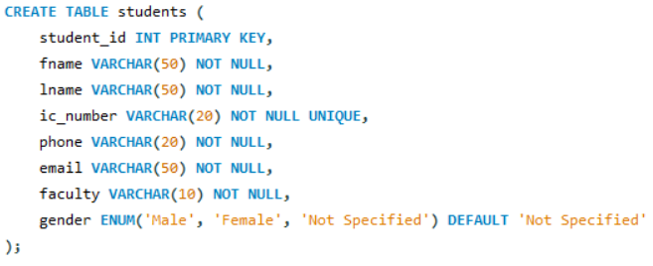
Database Structure
Tables created: students, room_types, room_locations, rooms, reservations, payments
Several constraints are used to ensure data integrity and consistency
www.utm.my
Notes:
There are total of 6 tables created within the system which are (read the slides). In each table, there are several attributes that support the operation of the system, and the tables are link together across the system.
I also applied several constraints so that the data remain consistent and accurate along the system.

Slide 8
Constraints
01
02
03
PRIMARY KEY
FOREIGN KEY
UNIQUE
Uniqueness per row
Relationship between tables
Prevent duplicates
04
05
06
NOT NULL
DEFAULT
CHECK
Required values
When not inserted with any values
Enforce logical rules
www.utm.my
Notes:
The constraints used are primary key to ensure each row have their own unique identifier in the table, foreign key to link a relationship between tables, unique to prevent duplicates of a certain field like IC number, not null to ensure the field has value and not empty, default so that when the fields are not inserted with any value, it has the default value. For example, a reservation date. Lastly, check constraints to enforce logical rules such as positive room pricing.

Slide 9
DML

Slide 10
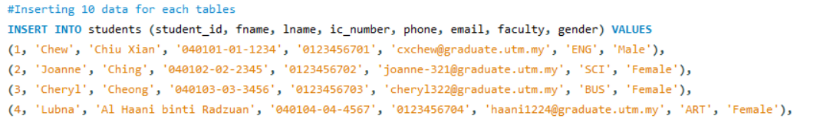
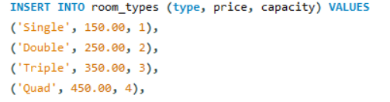
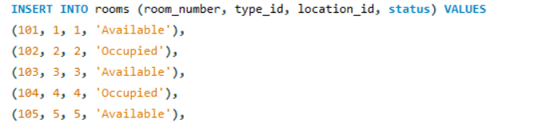
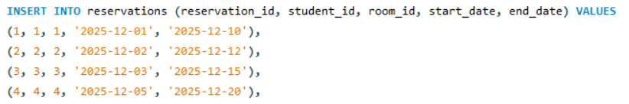
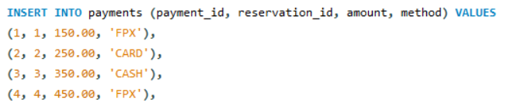
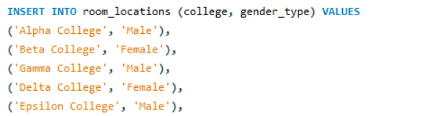
Data Insertion (Insert Statements)
1) Inserted sample data into all main tables:
customers
rooms
reservations
payments
2) Ensured foreign key order to avoid constraint errors.
3) Created realistic data for testing queries and system workflows.
www.utm.my

Slide 11

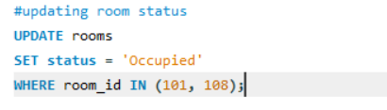
Updating Existing Data (UPDATE Statements)
Updated certain values to correct data inconsistencies.
Demonstrated how the system handles changes after records are created.
Used WHERE clause to avoid updating unintended rows.
www.utm.my

Slide 12
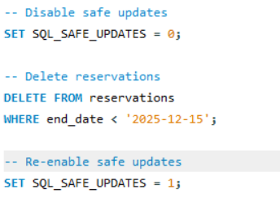
Deleting Data (DELETE Statements)
Demonstrated deletion of outdated or invalid records.
Carefully used conditions to avoid accidental full-table deletion.
Tested system behavior when linked records are removed.
www.utm.my

Slide 13
DQL / SELECT

Slide 14

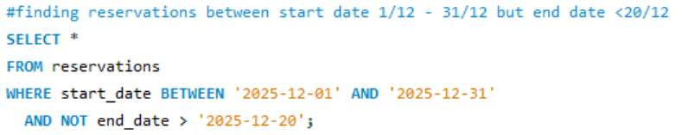
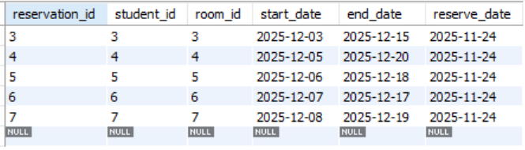

FILTERING
This query finds reservations that start between 1 December and 31 December but have an end date earlier than 20 December.
www.utm.my

Slide 15
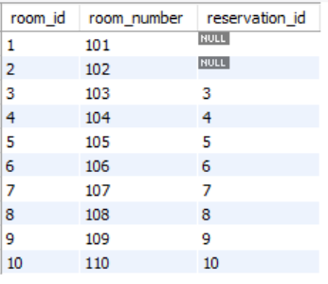
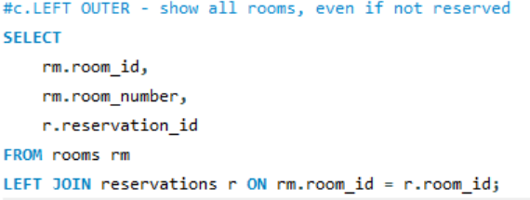
LEFT OUTER JOIN
This query lists every room, including those without reservations. NULL appears for rooms with no matching reservation.
www.utm.my

Slide 16
INDEXING

Slide 17
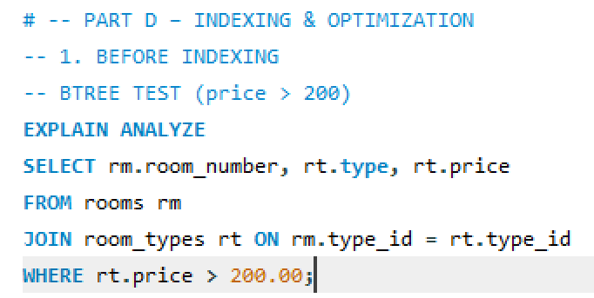
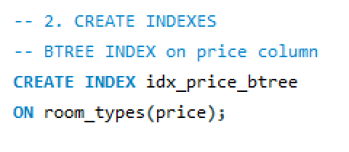
Optimizing Price Queries with B-TREE
Before Indexing:
Database performed a Full Table Scan (checking every row).
Query Cost: 4.75.
Solution: Implemented idx_price_btree on the room_types table.
After Indexing:
Enabled Range Access strategy.
Query Cost: Reduced to 2.42 (~50% efficiency boost).
www.utm.my

Slide 18
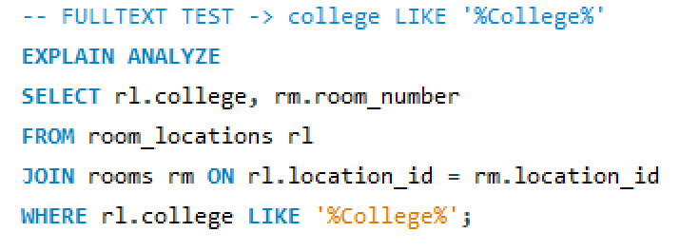
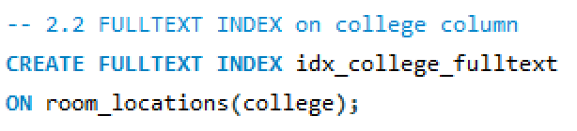
Text Search Optimization (FULLTEXT)
Scenario: Searching for specific keywords (e.g., "College") in location names.
Before Indexing:
Used LIKE '%College%', forcing the database to read every character.
Resulted in an inefficient Inner Hash Join.
Solution: Implemented idx_college_fulltext and used MATCH...AGAINST.
After Indexing:
Utilized Natural Language Mode for tokenized searching.
Query Cost: Drastically reduced to 0.70.
www.utm.my

Slide 19
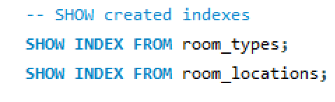
Validation of Results
Verification: Executed SHOW INDEX to confirm the structure of B-TREE and FULLTEXT keys.
Functional Testing:
Real-world queries now retrieve correct data
Eliminated bottlenecks in data retrieval.
Final Outcome: The database is now fully optimized and scalable for future data growth.
www.utm.my

